Slide 1
Chapter 6: Exceptions
Supervised BY: eng.Asmaa Ibrahim
Presented by: Habiba Ahmed

Slide 2
Agenda
Introduction
Understanding Exceptions
The Role of Exceptions
Understanding Exception Types
Runtime vs. at the Time the Program is Run
Checked Exceptions
Checked vs. Unchecked (Runtime) Exceptions
Using a try Statement
Adding a finally block
Catching Various Types of Exceptions
Throwing a Second Exception
Recognizing Common Exception Types
Printing an Exception
Summary
What will be discussed!

Slide 3
Introduction
Many things can go wrong in a program. Java uses exceptions to deal with some of these scenarios.

Slide 4
Understanding Exceptions
A program can fail for just about any reason. Here are just a few possibilities:
The code tries to connect to a website, but the Internet connection is down.
You made a coding mistake and tried to access an invalid index in an array.
One method calls another with a value that the method doesn't support.
As you can see, some of these are coding mistakes. Others are completely beyond your control.

Slide 5
The Role of Exceptions
An exception is Java's way of saying, "I give up. I don't know what to do right now. You deal with it."

Slide 6
Understanding Exception Types
As we’ve explained, an exception is an event that alters program flow. Java has a Throwable superclass for all objects that represent these events. Not all of them have the word exception in their classname, which can be confusing.

Slide 7
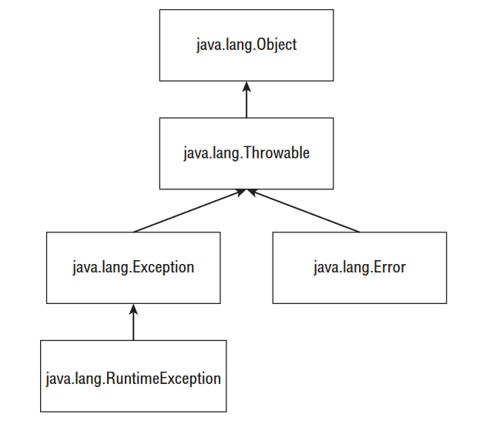
Understanding Exception Types Cont’d
Error means something went so horribly wrong that your program should not attempt to recover from it. For example, the disk drive “disappeared.” These are abnormal conditions that you aren’t likely to encounter.
A runtime exception is defined as the RuntimeException class and its subclasses. Runtime exceptions tend to be unexpected but not necessarily fatal. For example, accessing an invalid array index is unexpected. Runtime exceptions are also known as unchecked exceptions.

Slide 8
Runtime vs. at the Time the Program is Run
A runtime (unchecked) exception is a specific type of exception. All exceptions occur at the time that the program is run. (The alternative is compile time, which would be a compiler error.) People don’t refer to them as run time exceptions because that would be too easy to confuse with runtime! When you see runtime, it means unchecked.

Slide 9
Checked Exceptions
A checked exception includes Exception and all subclasses that do not extend RuntimeException. Checked exceptions tend to be more anticipated—for example, trying to read a file that doesn’t exist.
Checked exceptions? What are we checking? Java has a rule called the handle or declare rule. For checked exceptions, Java requires the code to either handle them or declare them in the method signature.

Slide 10
Checked Exceptions Example
This method declares that it might throw an exception:
void fall() throws Exception {
throw new Exception();
}
Notice that you’re using two different keywords here. throw tells Java that you want to throw an Exception. throws simply declares that the method might throw an Exception. It also might not.
Because checked exceptions tend to be anticipated, Java enforces that the programmer do something to show the exception was thought about. Maybe it was handled in the method. Or maybe the method declares that it can’t handle the exception and someone else should.

Slide 11
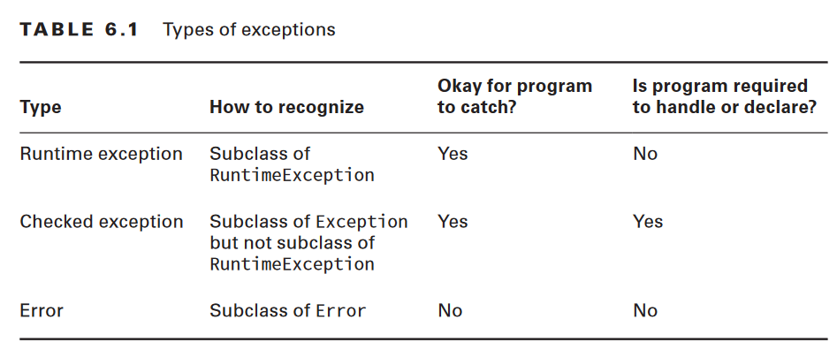
Table to show how the exceptions and errors are handled

Slide 12
Using a try Statement
Java uses a try statement to separate the logic that might throw an exception from the logic to handle that exception.
The code in the try block is run normally. If any of the statements throw an exception that can be caught by the exception type listed in the catch block, the try block stops running and execution goes to the catch statement. If none of the statements in the try block throw an exception that can be caught, the catch clause is not run.

Slide 13
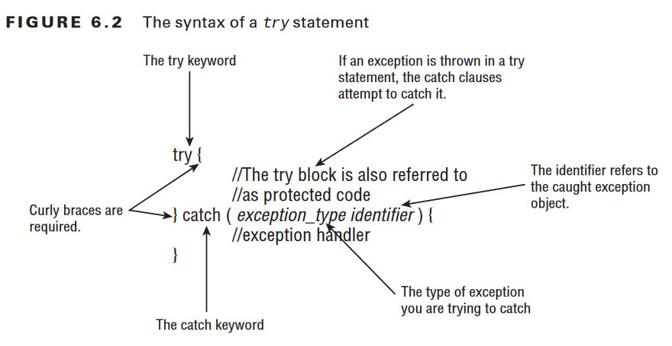
Using a try Statement Cont’d

Slide 14
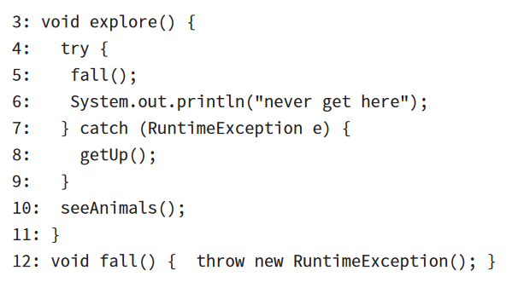
Using a try Statement example
In our example, the little girl gets up by herself the first time she falls. Here’s what this looks like:
First, line 5 calls the fall() method. Line 12 throws an exception. This means Java jumps straight to the catch block, skipping line 6. The girl gets up on line 8. Now the try statement is over and execution proceeds normally with line 10.

Slide 15
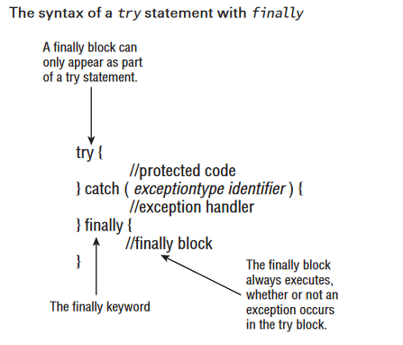
Adding a finally block
The try statement also lets you run code at the end with a finally clause regardless of whether an exception is thrown.
There are two paths through code with both a catch and a finally. If an exception is thrown, the finally block is run after the catch block. If no exception is thrown, the finally block is run after the try block completes

Slide 16
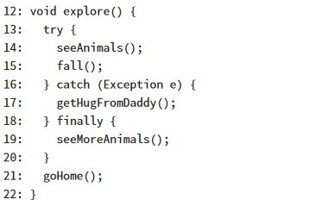
Adding a finally block example
The girl falls on line 15. If she gets up by herself, the code goes on to the finally block and runs line 19. Then the try statement is over and the code proceeds on line 21. If the girl doesn’t get up by herself, she throws an exception. The catch block runs and she gets a hug on line 17. Then the try statement is over and the code proceeds on line 21. Either way, the ending is the same. The finally block is executed and the try statement ends.

Slide 17
Catching Various Types of Exceptions
Now let’s see what happens when different types of exceptions can be thrown from the same method

Slide 18
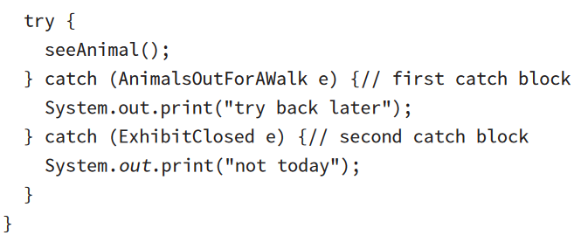
Catching Various Types of Exceptions Example
In this example, there are three custom exceptions. All are unchecked exceptions because they directly or indirectly extend RuntimeException. Now we catch both types of exceptions and handle them by printing out the appropriate message:
There are three possibilities for when this code is run. If seeAnimal() doesn’t throw an exception, nothing is printed out. If the animal is out for a walk, only the first catch block runs. If the exhibit is closed, only the second catch block runs

Slide 19
Throwing a Second Exception
So far, we’ve limited ourselves to one try statement in each example. However, a catch or finally block can have any valid Java code in it including another try statement.

Slide 20
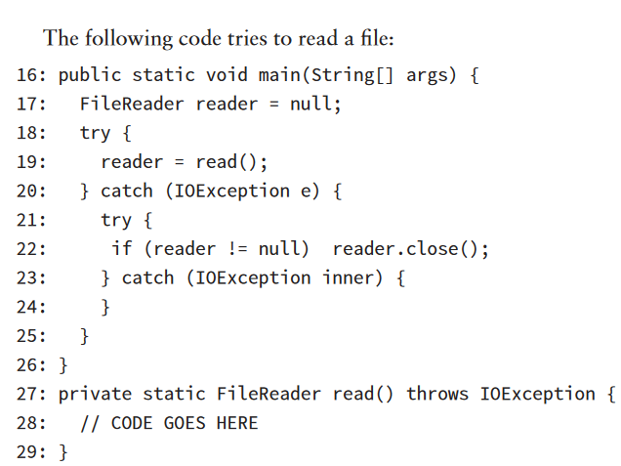
Throwing a Second Exception Example
The easiest case is if line 28 doesn’t throw an exception. Then the entire catch block on lines 20–25 is skipped. Next, consider if line 28 throws a NullPointerException. That isn’t an IOException, so the catch block on lines 20–25 will still be skipped.
If line 28 does throw an IOException, the catch block on lines 20–25 does get run. Line 22 tries to close the reader. If that goes well, the code completes and the main() method ends normally. If the close() method does throw an exception, Java looks for more catch blocks. There aren’t any, so the main method throws that new exception. Regardless, the exception on line 28 is handled. A different exception might be thrown, but the one from line 28 is done.

Slide 21
Recognizing Common Exception Types
Runtime Exceptions
Runtime exceptions extend RuntimeException. They don’t have to be handled or declared. They can be thrown by the programmer or by the JVM. Common runtime exceptions include the following:
ArithmeticException Thrown by the JVM when code attempts to divide by zero
ArrayIndexOutOfBoundsException Thrown by the JVM when code uses an illegal index to access an array
ClassCastException Thrown by the JVM when an attempt is made to cast an exception to a subclass of which it is not an instance
IllegalArgumentException Thrown by the programmer to indicate that a method has been passed an illegal or inappropriate argument
NullPointerException Thrown by the JVM when there is a null reference where an object is required
NumberFormatException Thrown by the programmer when an attempt is made to convert a string to a numeric type but the string doesn’t have an appropriate format

Slide 22
Recognizing Common Exception Types Cont’d
Checked Exceptions
Checked exceptions have Exception in their hierarchy but not RuntimeException. They must be handled or declared. They can be thrown by the programmer or by the JVM. Common runtime exceptions include the following:
FileNotFoundException Thrown programmatically when code tries to reference a file that does not exist
IOException Thrown programmatically when there’s a problem reading or writing a file

Slide 23
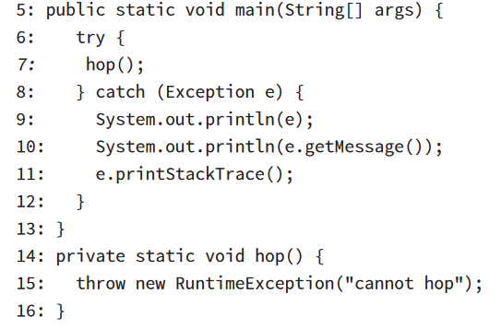
Printing an Exception
There are three ways to print an exception. You can let Java print it out, print just the message, or print where the stack trace comes from. This example shows all three approaches:

Slide 24
Summary
An exception indicates something unexpected happened. A method can handle an exception by catching it or declaring it for the caller to deal with. Many exceptions are thrown by Java libraries. You can throw your own exception with code such as throw new Exception().

Slide 25
Reference
OCA: Oracle Certified Associate Java SE Programmer | STUDY GUIDE

Slide 26
Questions?

Slide 27
Thank You!

